Slide 1


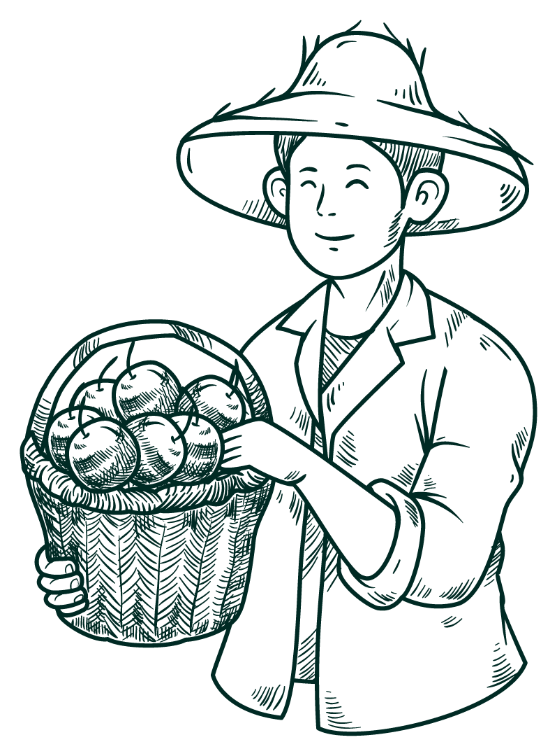



Socially Responsible Computing
What’s A Terminal?
By: Logan Gravitt, Jayden Mai, Ryan Miller, Brayan Ramos

Slide 2



Overview
Ethical Coding
Lopez Urban Farm
In this age of tech, coding can be dangerous when used wrong.
This project aims to implement ethical practices to help our community.
A non-profit community wellness project.
Supports locals of all status.
Backed by Cal Poly Pomona.

Slide 3
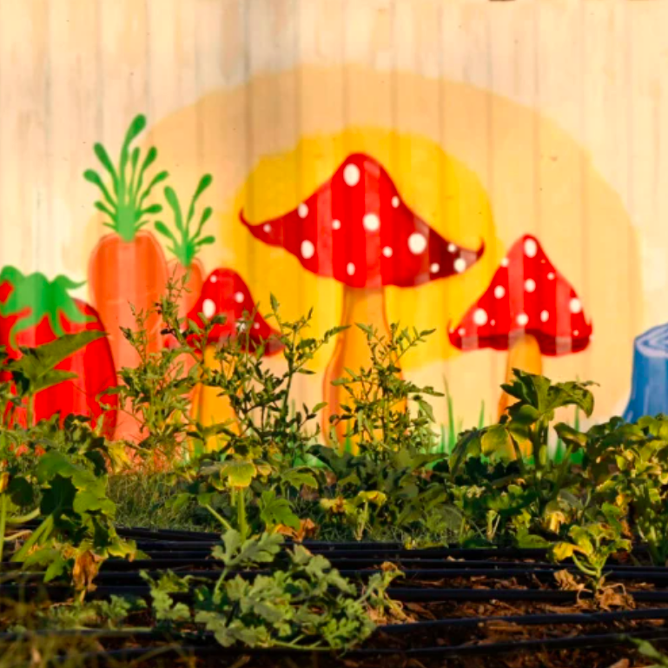

Problem Statement
After analyzing the Lopez Urban Farm, we realized a few critical pitfalls.
No effective management system for crops.
Visitors have no idea what is available and what is not.

Slide 4

Proposed Solution
Language | Java.
UI | Terminal Interface.
Program | Our program allows for the user to easily store and access data about the crops' availability. This simple program also saves data between sessions because we are using a database, which makes it useful and immediately applicable for the Lopez Urban Farm.
Database | Google Sheets, allows scalability and ease of access for the less technical.

Slide 5
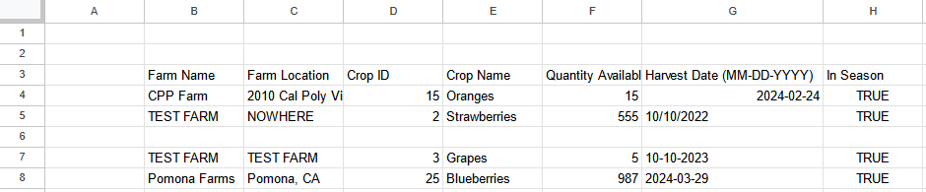
Google Sheets Database
Stores Farm Name/Location
Harvesting Data
Allows for Multiple sheets

Slide 6



Data Structures
Queue
List
First In, First Out.
Ensure modifications are handled in order.
Used to stage changes from the user to push onto the Google Sheets database.
Random Access.
Allow quick modifications to any part of the data set.
Used to hold the contents of a particular sheet within the Google Sheets database.

Slide 7


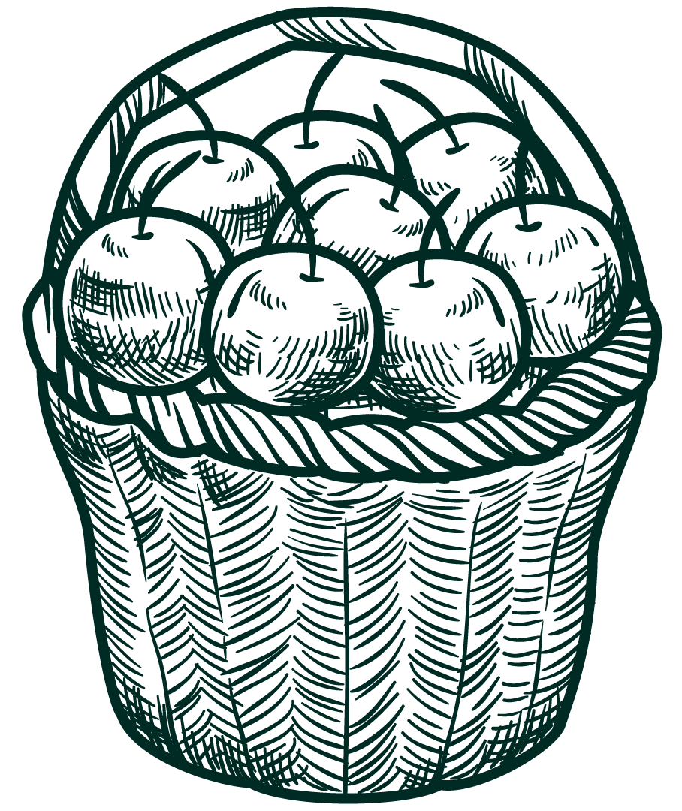
How the Code works
Google Sheets
Crop
Stores data in the Google Sheets as a database.
Uses an Authentication Token
Object with data on crop name, ID, quantity available, crop changes, harvest date, and in season.
Farm
Main
Object with specific data about the farm name and location.
Prompts the user for the menu.
Provides methods to update database.

Slide 8
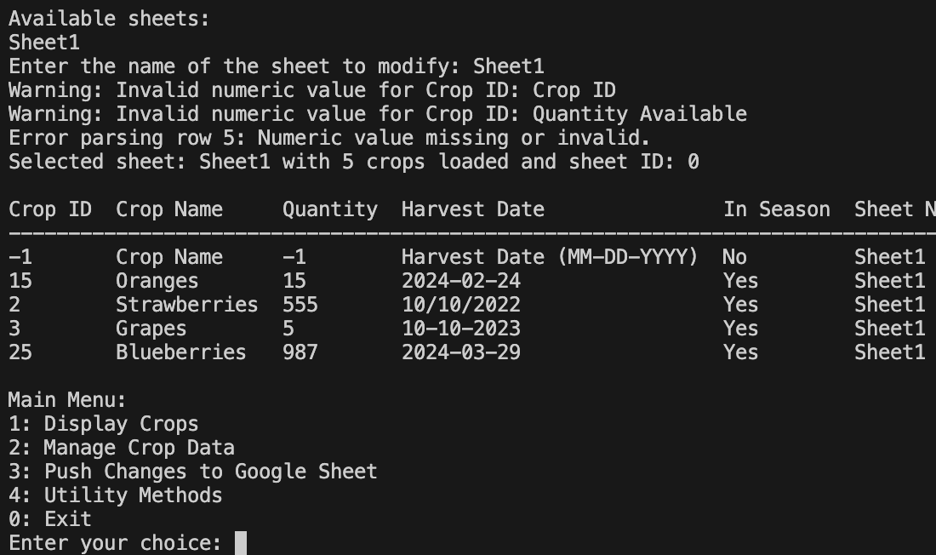
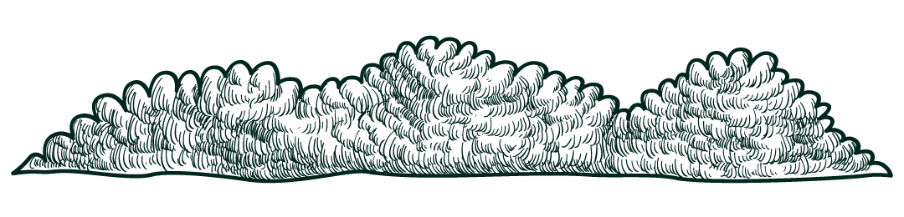
Demo

Slide 9

Challenges
Security:
Authentication tokens have to be managed carefully.
Possible limitations on who can access what data/sheet.
Testing:
Used JUnit5.
Ensure that a merge won’t break the main branch.
API CALLS:
Minimized API calls in order to provide better performance, cost, scalability, and reliability.

Slide 10
Alternative solutions
Google sheets alone
Disadvantages
Google or excel spreadsheet available to all volunteers.
Less user-friendly.
Harder to input the data.
Harder to keep the same format.
Slows down the data collection process.
Reduces efficiency.
Won’t scale well
Notebook or board
Handwriting all data in the same notebook available to all volunteers.

Slide 11
Future Expansion
Automatic Scaling
Web/Mobile Application
This program can grow along with the farm.
New farm locations, crops and sheets can all be added.
With this program acting as the backend, integrating this into a app is very feasible.
Allows for easier usage from less technical volunteers.
Data Analysis
Since the data is in a tabular format it can be easily transferred to other software.
For Instance, we can put this into graphs and records the changes over time.

Slide 12

Thanks!
Does anyone have any questions?
What’s A Terminal?

